Slide 1
AKS Networking
WorkshopPlus – Kubernetes Technical Briefing

Slide 2
Conditions and terms of use
© Microsoft Corporation. All rights reserved.
You may use these training materials solely for your personal internal reference and non-commercial purposes. You may not distribute, transmit, resell or otherwise make these training materials available to any other person or party without express permission from Microsoft Corporation. URL’s or other internet website references in the training materials may change without notice. Unless otherwise noted, any companies, organizations, domain names, e-mail addresses, people, places and events depicted in the training materials are for illustration only and are fictitious. No real association is intended or inferred. THESE TRAINING MATERIALS ARE PROVIDED “AS IS”; MICROSOFT MAKES NO WARRANTIES, EXPRESS OR IMPLIED IN THESE TRAINING MATERIALS¹

Slide 3

Learning Units covered in this Module
 | AKS Network Architecture
 | Container Networking Interfaces (CNIs)
 | AKS Ingress
 | AKS Egress
 | Advanced Container Networking Service (ACNS)

Slide 4

Objectives
After completing this Module, you will be able to:
 | 1 | Understand…. AKS Baseline architecture Protecting the
 | 2 | Understand…. The different Container Network Interfaces provided by Azure How to choose a CNI
 | 3 | Understand…. The different ways of exposing your application outside of the cluster How to choose an AKS Ingress implementation How Application Gateway for Containers works in this context
 | 4 | Understand…. The concept of egress control How to provide (outbound) internet access for your workloads
 | 5 | Understand…. What eBPF is How to gain granular network observability and control with ACNS

Slide 5
Intro: The many layers of Kubernetes Networking
When it comes to Kubernetes networking, there many levels:
  Connection to the Kubernetes API server
  (Internal) Pod-to-pod communication Accessing a Kubernetes workload from outside of the cluster
  Providing Kubernetes workloads with access to the Internet
In that context, you might want to:
  Limit in-cluster traffic to protect workloads
  Provide mTLS to establish trust across pods.
  Gain visibility on your network traffic (in and out of cluster)

Slide 6
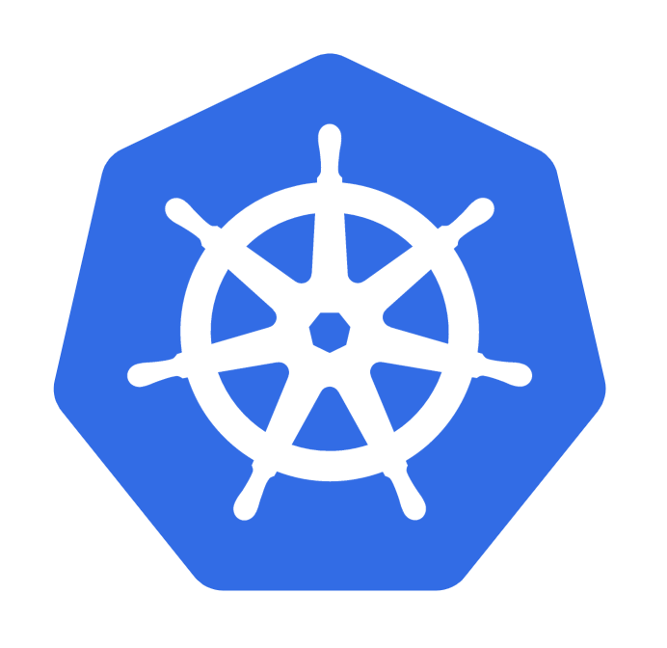
AKS Network Architecture
Understand its components and how to secure them

Slide 7
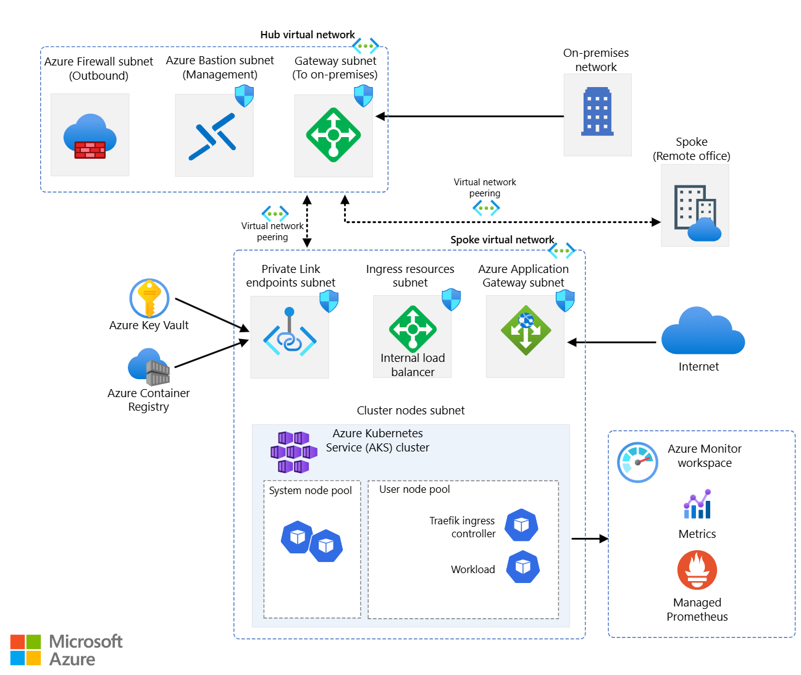
AKS Baseline Architecture
Notes:
Talk about the general baseline architecture:
Nodepools on Cluster nodes subnet.
Pods potentially on another subnet
Subnets for Ingress Resources / Private links.
Potential Egress through the Azure Firewall or on-premises connectivity
Need for IP address planning, as many resources will be deployed across the different subnets in the AKS vnet

Slide 8
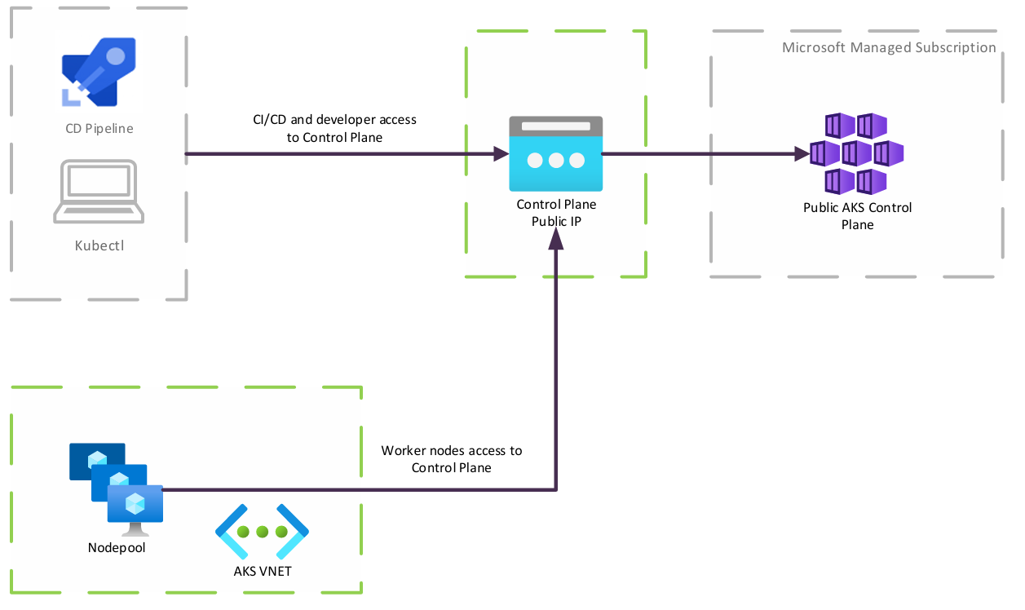
Public AKS Clusters
Kubernetes API Server gets a public IP address; therefore, the cluster is reachable from the public Internet.
Internet traffic can be restricted from given IP addresses or ranges (Whitelisting)
Default deployment mode
Node pools reside in an Azure VNET
Notes:
By default, the control plane receives a public IP address
There is a kind of Firewall applied to the controlplane, which can be used to allow Access from explicit IP address (ranges)

Slide 9
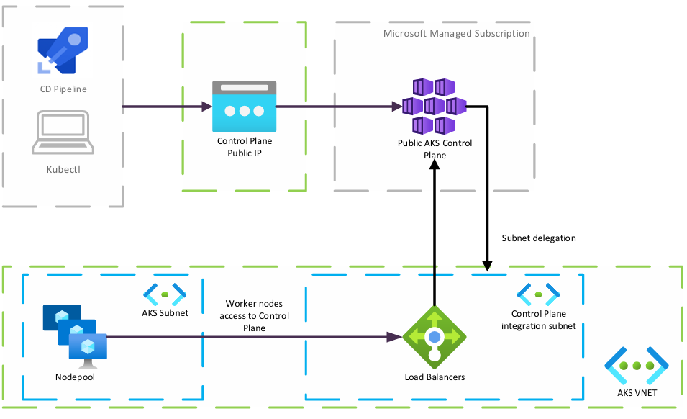
Public Cluster AKS Clusters – VNET Integration
Kubernetes API Server gets a public IP address; therefore, the cluster is reachable from the public Internet.
A subnet is created (and delegated) within the AKS VNET. This subnet contains a Load Balancer which provides private network connectivity between the worker nodepools and the AKS Control Plane.
Node pools reside in an Azure VNET
API Server VNet Integration has limited availability and capacity in certain regions.
Notes:
An Azure Kubernetes Service (AKS) cluster configured with API Server VNet Integration projects the API server endpoint directly into a delegated subnet in the VNet where AKS is deployed. API Server VNet Integration enables network communication between the API server and the cluster nodes without requiring a private link or tunnel. The API server is available behind an internal load balancer VIP in the delegated subnet, which the nodes are configured to utilize. By using API Server VNet Integration, you can ensure network traffic between your API server and your node pools remains on the private network only.
You can add or remove public access after cluster provisioning. Unlike non-VNet integrated clusters, the agent nodes always communicate directly with the private IP address of the API server internal load balancer (ILB) IP without using DNS. All node to API server traffic is kept on private networking, and no tunnel is required for API server to node connectivity. Out-of-cluster clients needing to communicate with the API server can do so normally if public network access is enabled.
API Server VNet Integration has limited availability and capacity in certain regions.
Once API Server VNet Integration is enabled on a cluster, stopping your cluster de-allocates the control plane and releases the capacity. In regions experiencing capacity constraints, customers may be unable to start a stopped cluster. We do not recommend stopping mission critical workloads for this reason.

Slide 10
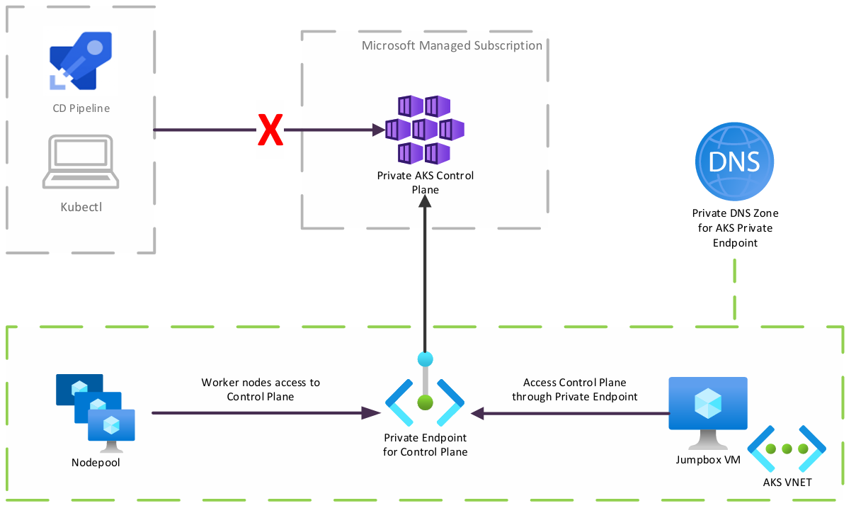
Private AKS Clusters
A Private Endpoint deployed in the AKS VNET provides private access to the AKS Control Plane API.
Ensures traffic between control plane and node pools remain in the private network.
API Server is accessible from the VNET which contains a private endpoint for the AKS Service
Node pools reside in an Azure VNET

Slide 11
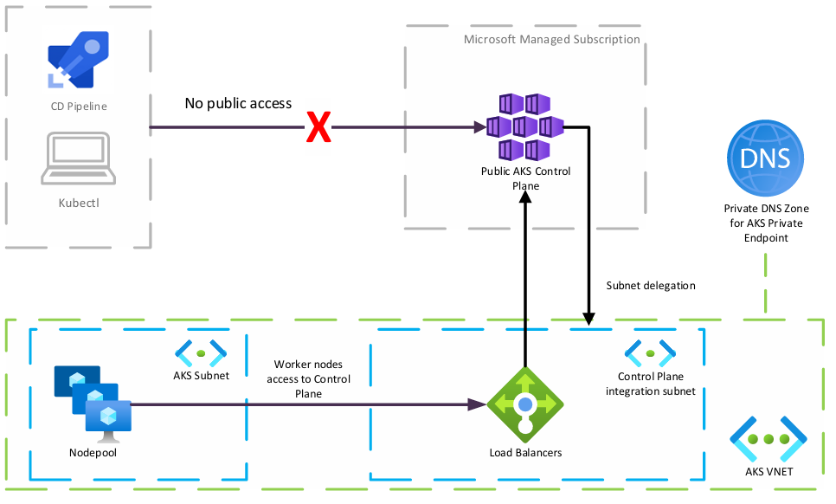
Private AKS Clusters – VNET Integration
Ensures traffic between control plane and node pools remain in the private network.
Developers and CI/CD pipelines use a private endpoint to connect to the cluster (not included in the diagram for simplicity)
Node pools reside in an Azure VNET
Notes:
Diagram does not include the Private Endpoint for AKS for simplicity

Slide 12


Container Networking Interfaces (CNIs)
Exploring the different options

Slide 13
AKS CNI Options
There are multiple network plugins available when creating a new AKS Cluster
Azure Container Networking Interface (CNI) networking plugin:
  The AKS cluster is connected to existing virtual network resources and configurations.
  Comes in one of 2 versions:
    Azure CNI Dynamic – Pod IP addresses are allocated from a separate subnet in VNet.
    Azure CNI Overlay - Pod IP addresses are allocated from an internal/separate subnet.
  Both CNI versions can be enhanced by enabling Cilium data plane and network policies. Azure CNI Powered by Cilium unlocks eBPF networking and observability features.
Bring your own Container Network Interface (CNI) plugin
Notes:
We will now explain the different CNI options in the following slides.

Slide 14
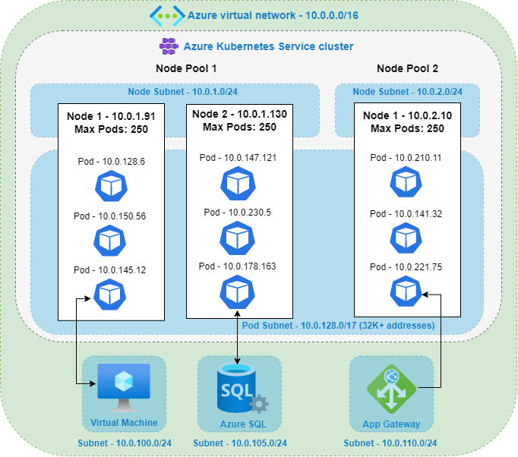
CNI Pod Subnet
Azure CNI with Dynamic IP allows Pods to be allocated IP addresses from a separate subnet within the cluster’s VNET.
Pods get IP addresses from the subnet and are directly accessible from other devices on the same the VNET.
IP addresses must be unique across the network space.
The same Pods subnet can be used on multiple clusters.
Requires planning but is less likely to lead to IP address exhaustion because no IPs are pre-allocated and possibly “wasted”.
Notes:
T

Slide 15
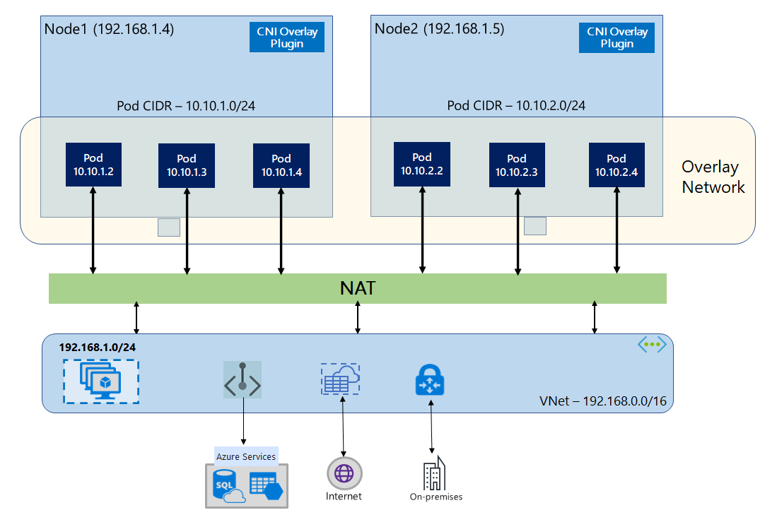
CNI Overlay
Azure CNI Overlay is the default network plugin when no plugin is specified:
  Recommended configuration for most production clusters.
  Pods receive IP addresses from an internal address space, logically different from the Nodes’ Vnet, therefore NOT directly accessible from outside the cluster.
  External access goes through a NAT layer
Notes:
Azure CNI Overlay assigns IP addresses from the user-defined overlay address space instead of using IP addresses from the VNET. It uses the routing of these private address spaces as a native virtual network feature. This means that cluster nodes do not need to perform any extra encapsulation to make the overlay container network work. This also allows this overlay addressing space to be reused for different AKS clusters even when connected via the same VNET.
When a node joins the AKS cluster, we assign a /24 IP address block (256 IPs) from the Pod CIDR to it. Azure CNI assigns IPs to Pods on that node from the block, and under the hood, VNET maintains a mapping of the Pod CIDR block to the node. This way, when Pod traffic leaves the node, VNET platform knows where to send the traffic. This allows the Pod overlay network to achieve the same performance as native VNET traffic and paves the way to support millions of pods and across thousands of nodes.

Slide 16
CNI Overlay - Benefits
Azure CNI Overlay benefits:
  Supports larger clusters: max 1000 nodes and 250 pods/node
  Simple network configuration: no additional configuration required for pod networking (no route tables or UDR required)
  Pod connectivity performance on par with VMs in a Vnet
  Supports Egress Gateway
  Supports several Kubernetes Network Policy plugins: Azure, Calico, Cilium
  Supports both Linux and Windows Server 2022 nodes

Slide 17
CNI Comparison
Area | Azure CNI Dynamic | Azure CNI Overlay
Limited IP space | IPs part of VNet | Internal IPs
Cluster size (max nodes) | 5000 | 1000
Pods per node (default/max) | 30/250 | 250/250
Internal network configuration | Integrated into existing Vnet | Simple
Pod connectivity performance | On par with VMs in a VNet | On par with VMs in a VNet
Network Policies | Azure Network Policies, Calico, Cilium | Azure Network Policies, Calico, Cilium
OS Supported | Linux, Windows Server 2019, 2022 | Linux, Windows Server 2022
Virtual Nodes supported | Yes | No
Notes:
The two main networking models in AKS are overlay and flat networks.
Overlay networks:
Conserve VNet IP address space by using logically separate CIDR ranges for pods.
Maximum cluster scale support.
Simple IP address management.
Flat networks:
Pods get full VNet connectivity and can be directly reached via their private IP address from connected networks.
Require large, non-fragmented VNet IP address space.
Depending on the CNI you use, your cluster virtual network resources can be deployed in one of the following ways:
The Azure platform can automatically create and configure the virtual network resources when you create an AKS cluster. like in Azure CNI Overlay, Azure CNI Node subnet, and Kubenet.
You can manually create and configure the virtual network resources and attach to those resources when you create your AKS cluster.

Slide 18
Selecting the Right Network Plugin
Use Azure CNI Classic/Dynamic when:
  You have available IP address space.
  Resources outside the cluster need to reach pods directly (like App Gateway or whitelisting IPs).
  Most of the pod communication is to resources outside of the cluster.
  You plan on using Virtual Nodes.
Use Azure CNI Overlay for clusters that require large scale, simplified IP management, or Windows Server 2022 nodes:
  Also need Windows 2022 nodes.
  Want to use Azure Network Policies
Use Azure CNI Powered By Cilium either on Overlay or Dynamic mode to take advantage of advanced networking and eBPF based features.

Slide 19
Bring Your Own CNI plugin with AKS
Advanced users of AKS may wish to utilize the same CNI plugin used in on-premises Kubernetes environments or to make use of specific advanced functionality available in other CNI plugins not available in Azure CNI.
Certain requirements must be met for AKS to work with an external CNI Plugin:
    The virtual network for the AKS cluster must allow outbound internet connectivity.
    AKS clusters may not use 169.254.0.0/16, 172.30.0.0/16, 172.31.0.0/16, or 192.0.2.0/24 for Kubernetes service address range, pod address range, or cluster virtual network address range.
    The cluster identity used by the AKS cluster must have at least Network Contributor permissions on the subnet within your virtual network.
    The subnet assigned to the AKS node pool cannot be a delegated subnet.
    AKS doesn't apply Network Security Groups (NSGs) to its subnet and will not modify any of the NSGs associated with that subnet.
    Microsoft support will not be able to assist with CNI-related issues in BYOCNI clusters

Slide 20
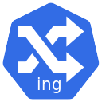
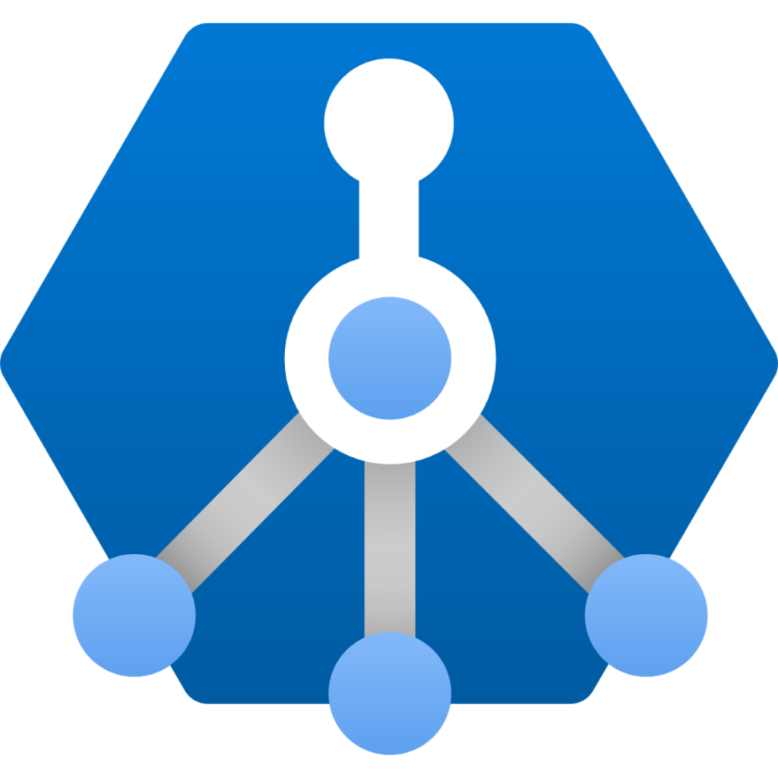
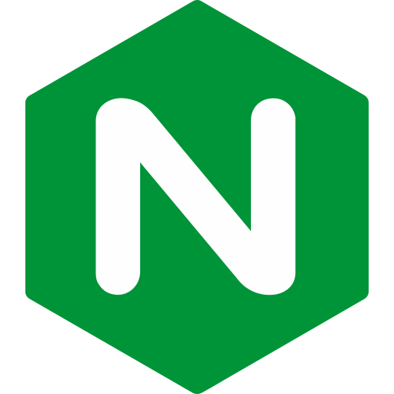
AKS Ingress
Exploring the different options

Slide 21
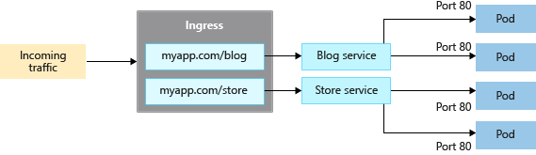
Kubernetes Ingress API
To provide access to a workload running on Kubernetes, it must have an IP address which is accessible from outside the cluster. While you could assign Load Balancer IPs to multiple services, you will have to deal with IP address exhaustion in the Load Balancer subnet.
Although Ingress is a core Kubernetes resource in its API, it is not possible to provide access through an Ingress without first provisioning an ingress controller in the cluster.
Ingress controllers provide advanced capabilities at Layer 7, such as path-based routing.
Notes:
This has been the standard for providing external access to Kubernetes workloads for many years.

Slide 22
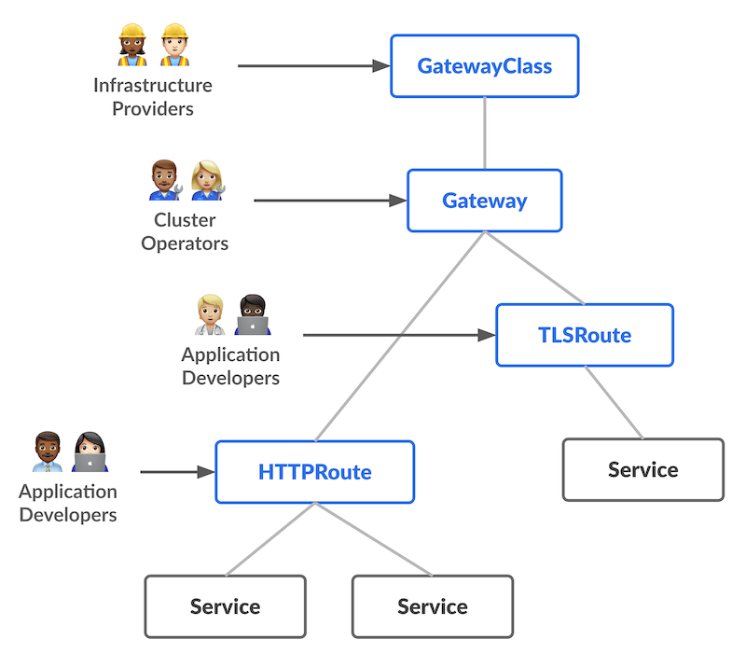
Kubernetes Gateway API
Gateway API is the evolution of the Ingress API
Separation of concerns:
  Infrastructure providers define GatewayClass
  Cluster operators deploy Gateways, which get consumed by Application Developers who create TLSRoutes, HTTPRoutes…
Expose applications over multiple protocols:
  TCP
  UDP
  HTTP
  TLS
  gRPC
Implemented in Azure with Application Gateway for Containers
Notes:
Specifying the network plugin the AKS cluster will use can only be done when the cluster is created and cannot be changed afterwards.

Slide 23
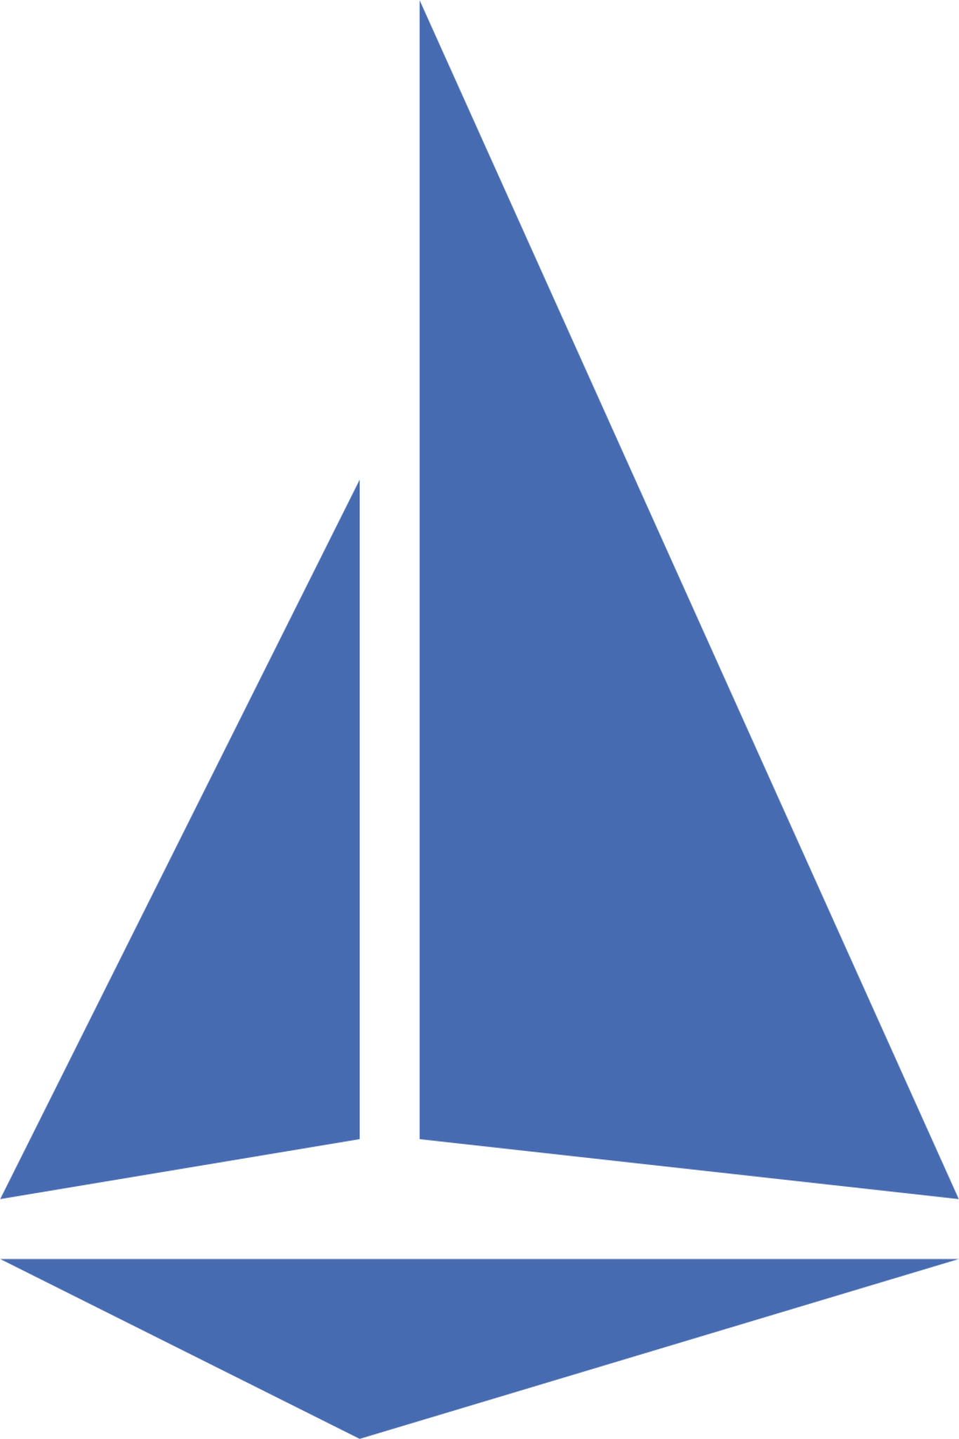
AKS Ingress Options
Choose one for exposing your Kubernetes based applications outside of the cluster
Managed NGINX – Application Routing Addon
In-cluster hosted, customizable, and scalable NGINX ingress controllers which provide basic load balancing and routing capabilities for both internal and external load balancer configurations.
Integrates with Azure Key Vault for certificate management and with Azure DNS Zones for public and private DNS management.
Supports the Ingress API
Application Gateway for Containers
Layer 7 gateway which supports both Ingress and Gateway API
Components:
  Frontends: Unique FQDN.
  Associations: Connection point to a virtual network. 1:1 mapping to a Subnet that has been delegated
  ALB Controller: 2 pod deployment that orchestrates configuration and deployment of Application Gateway for Containers by watching Kubernetes API.
Azure Service Mesh / Istio-based service mesh
Based on Envoy, when using with Istio for a service mesh.
Advanced traffic management features such as rate limiting and circuit breaking, as well as support for mTLS.

Slide 24
Demo: Application Gateway for Containers
See it in action!
Understand and visualize the capabilities of Application Gateway for Containers.
Visualize configuration and components.
Expose an Application as Ingress
Expose an Application as HTTPRoute
Notes:
Consider demoing the following:
##########

Slide 25
AKS Egress
Exploring the different options

Slide 26
Egress Traffic Control
Egress traffic refers to the data leaving Azure. In this context, egress traffic control involves monitoring, filtering, and protecting outbound data to ensure it only exits your virtual network under authorized conditions.
Egress control is fundamental for preventing data exfiltration, in which a malicious actor can send data to any public endpoint.
Notes:
Specifying the network plugin the AKS cluster will use can only be done when the cluster is created and cannot be changed afterwards.

Slide 27
AKS Egress Options (Outbound Types)
Choose one for exposing your Kubernetes based applications outside of the cluster
Load Balancer
A public IP address is created for cluster egress and assigned to the Load Balancer resource.
Used in
User Defined Routing
Egress is defined by a route table that the user attaches to the subnet where the AKS cluster nodes will be deployed. Used for routing force traffic via Azure Firewall or a partner’s Network Virtual Appliance (NVA), which will provide egress control.
Managed Gateway or
User Assigned Gateway
  A NAT Gateway which gets attached to the subnet and provides internet connectivity to all devices connected to it. Use when you have no strict egress control requirements. Non-recommended.
None
Route table which does not require a default route. Used in BYO CNI scenarios.
None
Similar to userDefinedRouting but does not require a default route. Used in Bring your own CNI scenarios.
Notes:
Changing outbound type of an existing cluster is supported for some scenarios.

Slide 28
Outbound Types
There are 5 types of outbound types for AKS egress:
loadBalancer: A public IP address is created for cluster egress and assigned to the Load Balancer resource.
managedNatGateway or userAssignedNatGateway: A NAT Gateway which gets attached to the subnet and provides internet connectivity to all devices connected to it. Use when you have no strict egress control requirements. Non-recommended.
userDefinedRouting: Egress is defined by a route table that the user attaches to the subnet where the AKS cluster nodes will be deployed. Used for routing force traffic via Azure Firewall or a partner’s Network Virtual Appliance (NVA), which will provide egress control.
none: Similar to userDefinedRouting but does not require a default route. Used in Bring your own CNI scenarios.
block: AKS configures network rules to actively block all egress traffic from the cluster. For air-gapped environments where AKS clusters MUST NOT have outbound connectivity towards the public internet.
Changing outbound type of an existing cluster is supported for some scenarios.

Slide 29
(Preview) AKS Static Egress Gateway
Static Egress Gateway isn't supported in clusters with Azure CNI Pod Subnet.
Kubernetes network policies won't apply to traffic leaving the cluster through the gateway node pool.
This shouldn't affect cluster traffic control as only egress traffic from annotated pods routed to the gateway node pool are affected.
The gateway node pool isn't intended for general-purpose workloads and should be used for egress traffic only.
Windows node pools can't be used as gateway node pools.
hostNetwork pods cannot be annotated to use the gateway node pool.
Pods can only use a gateway node pool if they are in the same namespace as the StaticGatewayConfiguration resource.
Notes:
Specifying the network plugin the AKS cluster will use can only be done when the cluster is created and cannot be changed afterwards.

Slide 30
Demo: AKS Egress with Azure Firewall
See it in action!
Understand how egress routing is configured for AKS
Visualize allowed and dropped traffic from Azure Firewall logs
Notes:
Consider demoing the following:
Display Grafana dashboards from the Azure Portal.
Container Network Logs with Advanced Container Networking Services - Azure Kubernetes Service | Microsoft Learn

Slide 31

Advanced Container Networking Service (ACNS)
Enhanced network and observability suite

Slide 32
What is eBPF?
eBPF, often interchangeably used with BPF, is the Berkeley Packet Filter.
Enables you to run custom code directly within the kernel, without modifying the source code or loading new modules.
It allows you to intercept and analyze network traffic, monitor system performance, or enforce security polices with minimal overhead.
It usually gets enabled in a cluster which runs a CNI that leverages it, such as Cilium.
Can be enabled in any AKS cluster (with any CNI) thanks to the Advanced Container Networking Service.
Notes:
Source: Understanding eBPF and Its Application in Modern Cloud Environments 🚀 - DEV Community

Slide 33
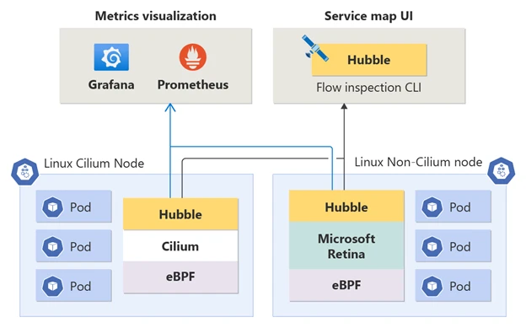
Advanced Container Networking Service (ACNS)
Suite of services used to enhanced network capabilities of AKS.
Unlocks a large number of eBPF-based metrics, which can be collected with Prometheus and visualized with Grafana.
Easily enabled in Cilium and non-Cilium based clusters.
Notes:
Specifying the network plugin the AKS cluster will use can only be done when the cluster is created and cannot be changed afterwards.

Slide 34
ACNS – Container Network Observability
CNI-Agnostic
It enables eBPF-based metrics on non-cilium AKS clusters
Integrates seamlessly with (Managed) Prometheus and Grafana
Enables Hubble
Notes:
Specifying the network plugin the AKS cluster will use can only be done when the cluster is created and cannot be changed afterwards.

Slide 35
ACNS – Container Network Security
Currently there are two main features in the Container Network Security offering:
FQDN Filtering: Enhances egress control with Azure CNI Powered by Cilium’s DNS-based policies.
Layer 7 Policy: Gain granular control over application-level traffic by implementing policies based on protocols such as HTTP(s), gRPC and Kafka.
Notes:
Specifying the network plugin the AKS cluster will use can only be done when the cluster is created and cannot be changed afterwards.

Slide 36



Demo: Advanced Container Networking Service
See it in action!
Understand and visualize the capabilities of Advanced Container Networking Service
Visualize FQDN filtering and internal cluster network flows with Hubble
Visualize ACNS enabled metrics
Notes:
Consider demoing the following:
Display Grafana dashboards from the Azure Portal.
Container Network Logs with Advanced Container Networking Services - Azure Kubernetes Service | Microsoft Learn
Enabling ACNS on existing cluster:
# Install the aks-preview extension
az extension add --name aks-preview
# Update the extension to make sure you have the latest version installed
az extension update --name aks-preview
az feature register --namespace "Microsoft.ContainerService" --name "AdvancedNetworkingL7PolicyPreview“
az feature show --namespace "Microsoft.ContainerService" --name "AdvancedNetworkingL7PolicyPreview“
az aks update --resource-group $RESOURCE_GROUP --name $CLUSTER_NAME --enable-acns --acns-advanced-networkpolicies <L7/FQDN>
Demo:
Wait for the cluster to be in succeeded state
Log in to Grafana, to show how it works with Entra ID out of the box.
Display

Slide 37
Lab 1: Ingress with Application GW for Containers
Lab Description
Create a public AKS cluster with CNI Overlay powered by Cilium.
Deploy the ALB Controller with Helm.
Expose an application outside of the cluster as HTTPRoute.
Notes:
Link to lab: https://labondemand.com/LabProfile/
##########

Slide 38
Lab 2: ACNS (Optional)
Lab Description
Control traffic flows by enforcing Network Policies.
Controle outbound traffic by configuring FQDN Filtering.
Introduce chaos in a running application and visualize its effects with Grafana.
Deploy Hubble and observe network flows.
Notes:
Link to lab: https://labondemand.com/LabProfile/
##########

